Slide 1

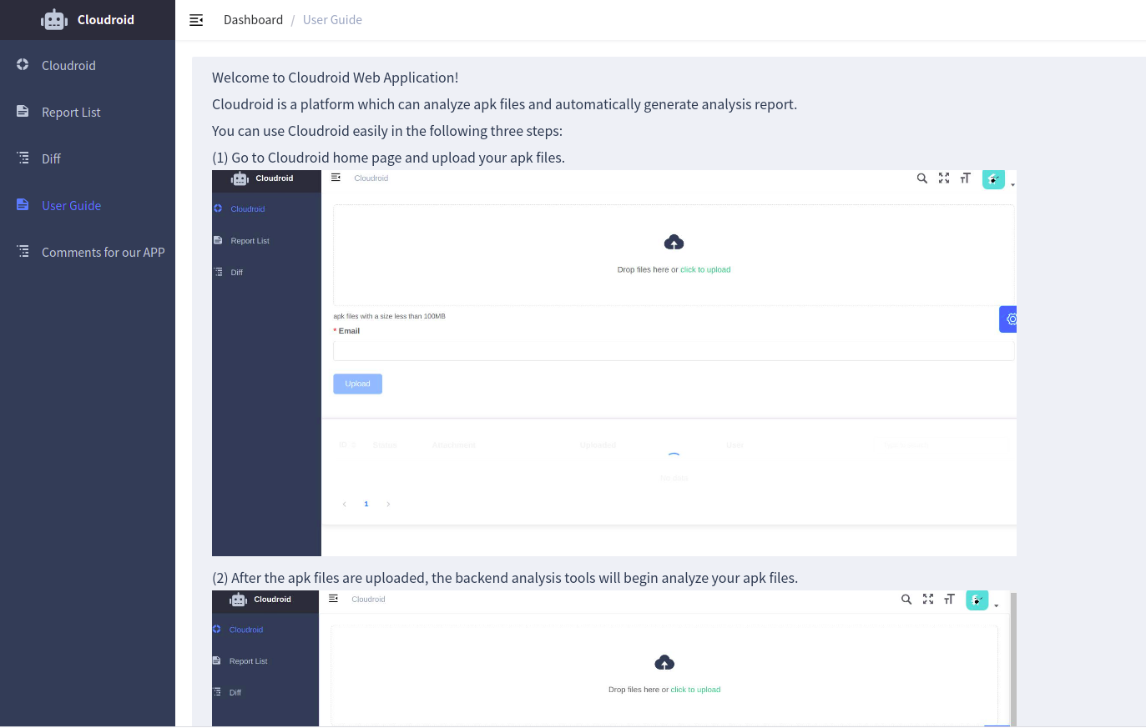
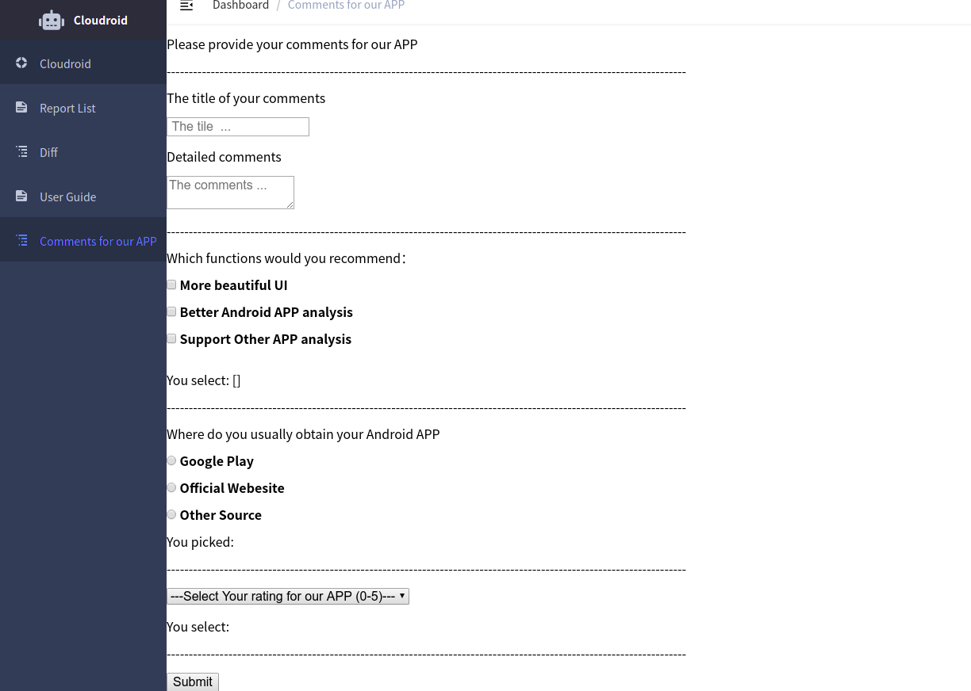

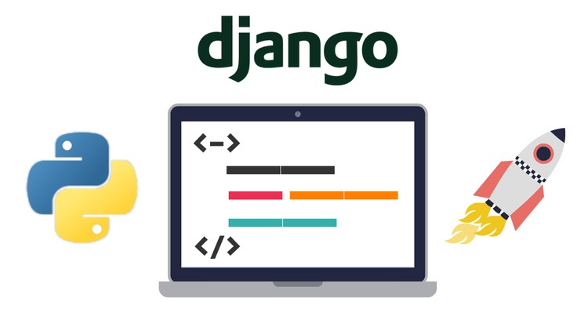



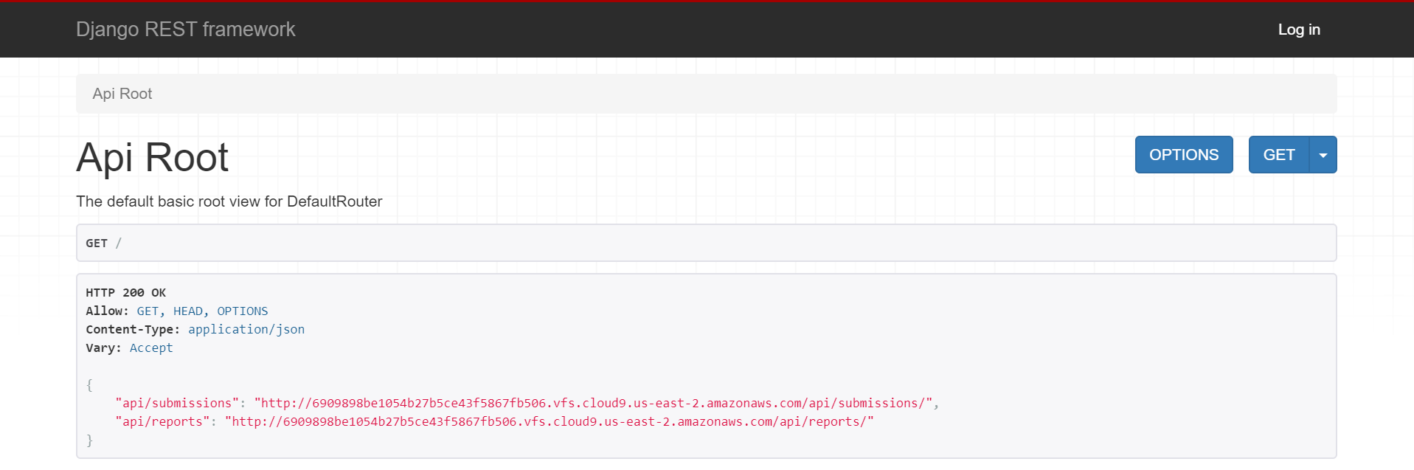
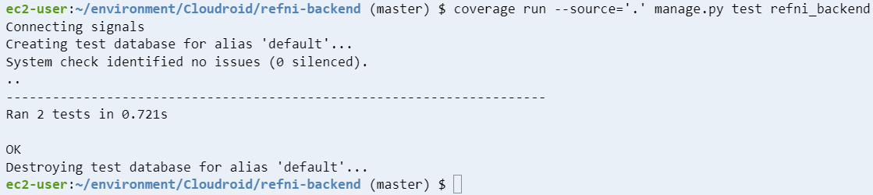
Cloudroid: A Web Android Static Analysis Tool
Xin Chang, Zhenhua He, Hung-Yi Chen, Yifan Jiang, Youzhi Luo, Hao Yuan
Dept. of Computer Science and Engineering, Texas A&M University
Introduction
User Interface (Vuejs Element Admin)
Android APK Analysis Framework:
Check if the Android APK is bugs-free.
Users can upload their Android APK and receive the results via e-mail they assign.
This framework communicates with Flowdroid service to generate a report.
Ideas:
A Vuejs frontend to service users’ requests, including Users’ Uploads, Processing Progress, Visualizations of results.
A Django backend to tackle works from Vuejs, and communicate with Flowdroid service, to support the CRUD operations and READ operation on users’ submissions and analysis reports, respectively.
Flowdroid: a pre-existing android APK static analysis tool, into a dockerized web service.
Challenges:
Implementing BDD/TDD Testing on this large system.
The connections and communications between these blocks.
Add some more new functionalities to facilitate user use and comments.
Two more Improved Functionalities are added:
User guide with detailed procedures.
User comments and feedback for the Cloudroid APP.
User Guide
Overall Flow
User Comments
Vuejs
Front End
Request
Render
Back End
Save Report
JSON
Load APK
Return Results
Query Report
Backend Processor (Django Server)
The Backend Processor and BDD/TDD Testing:
The backend processor interface.
BDD/TDD tests by coverage tool to verify submission and report functionalities.
Flowdroid
Kubernetes
Future Work
Github
Achieving better communication between different modules of this project .
Utilizing Kubernetes cluster to scale up the Flowdroid android APK static analysis service.
Deploying to the cloud (funding support may be needed).
Introducing more thorough BDD/TDD tests to both front end and backend functionalities.
Video
Notes:
1

